Slide 1
Cyber Security Careers
Vignesh C

Slide 2
So Let’s Talk About Me…
7+ Experience in cyber security
Worked for 150+ projects in various aspects of cyber security
Have 50+ hall of fames
Independent Consultant
Had 3 international research to my name
Global top 10 in htb,ctfs etc.

Slide 3
Topics
Define Cybersecurity
Define Pivoting
Demand for Cybersecurity Professionals
Cybersecurity Fields & Careers
Technical, Physical, and Administrative Controls
You May Already Be Involved in Cybersecurity
Training Resources
Certifications
Networking
Professional Reading
Resumes & Applicant Tracking Systems

Slide 4
What is Cybersecurity?
Cybersecurity encompasses a broad range of practices, tools and concepts related closely to those of information and operational technology security. Cybersecurity is distinctive in its inclusion of the offensive use of information technology to attack adversaries.“
Gartner “Definition: Cybersecurity”, 07 June 2013
"Measures taken to protect a computer or computer system (as on the Internet) against unauthorized access or attack.“
Merriam-Webster
https://www.merriam-webster.com/dictionary/cybersecurity

Slide 5
What is Pivoting?
Pivoting is the exclusive method of using an instance also known by ‘foothold’ to be able to “move” from place to place inside the compromised network. It uses the first compromised system foothold to allow us to compromise other devices and servers that are otherwise inaccessible directly. https://resources.infosecinstitute.com/pivoting-exploit-system- another-network/

Slide 6
Demand for Cybersecurity Professionals
Demand for Cybersecurity Talent Soars, Study Finds
25 percent gap between demands for cyber talent and qualified workforce
Predicts a shortfall of 3.5 million cybersecurity professionals by 2021
Using existing talent
Closing the gap with “new collar workers” https://securityintelligence.com/news/demand-for-cybersecurity-talent-soars-study-finds/
Demand for Cybersecurity Jobs Doubles Over Five Years, But Talent Gap Remains
https://www.prnewswire.com/news-releases/demand-for-cybersecurity-jobs- doubles-over-five-years-but-talent-gap-remains-300874877.html
The 10 highest-paying cybersecurity jobs
https://www.techrepublic.com/article/the-10-highest-paying-cybersecurity-jobs/

Slide 7
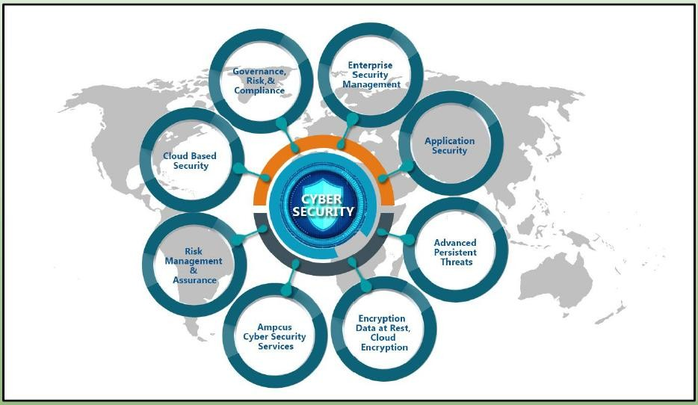
Cybersecurity Fields

Slide 8
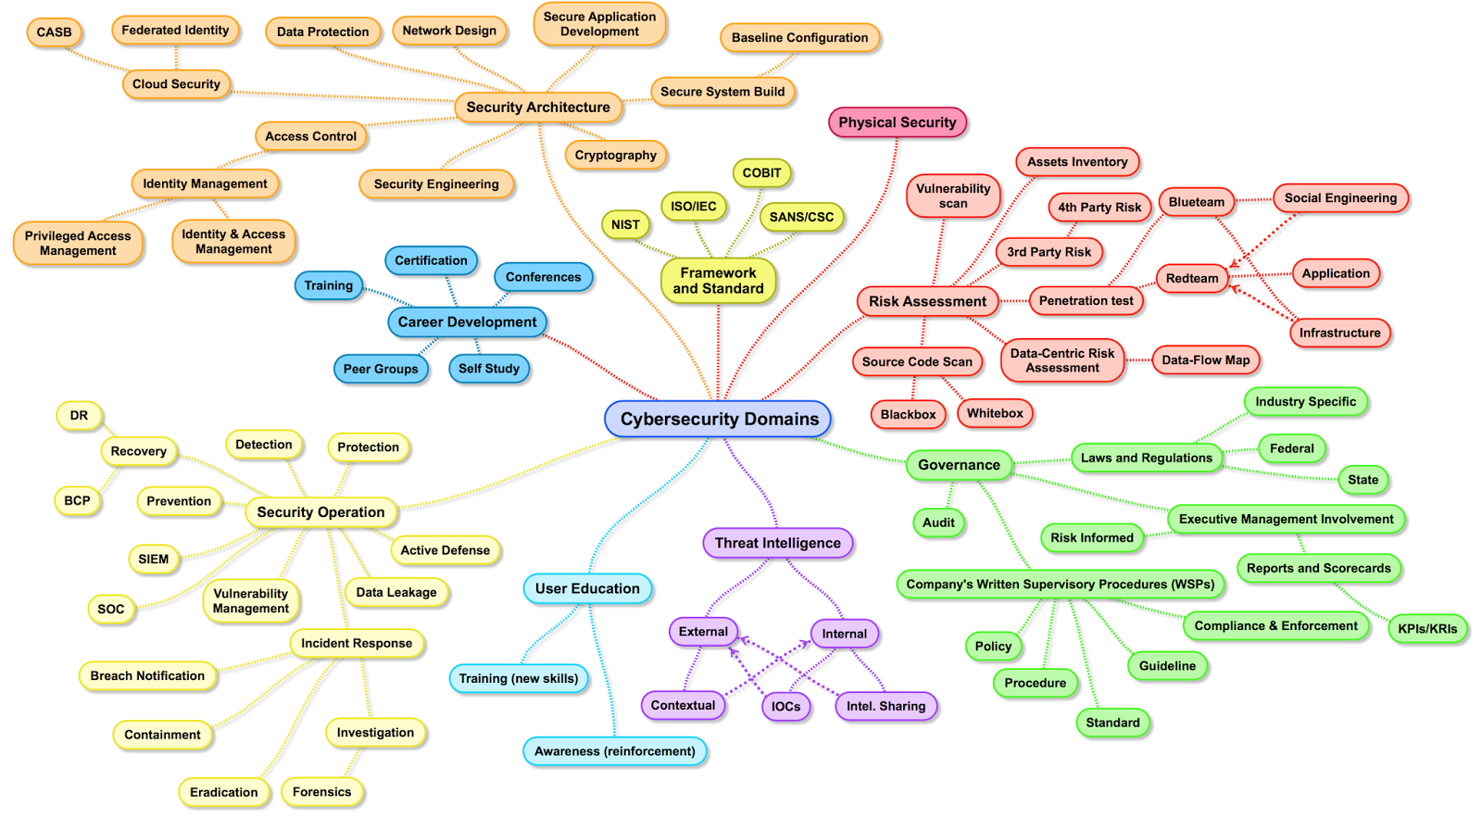
Cybersecurity Fields

Slide 9
Careers in Cybersecurity
Security Analyst
Security Architect
Security Software Developer
Security Systems Engineer
Security Administrator
Security Consultant
Forensics Examiner
Penetration Tester
Cryptographer
Cryptanalyst
Information System Security
Manager
Sales
Quality Assurance
Law
Insurance
References:
“Learn How to Become” https://www.learnhowtobecome.org/computer-careers/cyber-security/ “Cyber Security Jobs: Opportunities for Non-Technical Professionals” https://onlinedegrees.sandiego.edu/non-technical-cyber-security-jobs/ “Getting Started in Cybersecurity with a Non-Technical Background” https://www.sans.org/security-awareness-training/blog/getting- started-cybersecurity-non-technical-background

Slide 10
Technical, Administrative, and Physical Controls
Technical - Hardware or Software Solutions
Firewalls
Intrusion Detection or Prevention Systems (IDS / IPS)
Biometric Authentication
Permissions
Auditing
Administrative – implemented with policies and procedures
Fulfill legal requirements
Customer Privacy
Password Policy
Length, Complexity, Frequency of Change
User Agreement
Physical – protect assets from both hackers and traditional threats https://www.asisonline.org
Guards
Locks
Cameras
Fire Protection
Oriyano, S. (2014) Hacker Techniques, Tools, and Incident Handling, 2nd Edition, Burlington, MA: Jones & Bartlett Learning

Slide 11
You May Already be Involved in Cybersecurity!
Most computer vulnerabilities can be traced to:
Poorly implemented software
Failure to sanitize inputs
Incorrectly administered systems
Failure to disable inactive user accounts
Poorly designed systems
Meltdown and Spectre
Poor “cyber hygiene”
Lack of patch updates
If your job involves designing or administering information systems or developing software, you are effectively supporting cybersecurity efforts.

Slide 12
Cybersecurity Training
College Degree versus Technical Certification
Many, but not all, positions require a four year degree
However, an additional degree may not be the best route to transition to cybersecurity
Depends on your original degree
Video: Success in the New Economy https://vimeo.com/67277269
National Centers of Academic Excellence in Cyber Defense 2-Year Education (CAE-2Y) https://www.iad.gov/NIETP/reports/cae_designated_institutions.cfm#C
There are three community colleges in Southern California with this designation
Coastline, Cypress, and Long Beach City College
There are also four 4-year colleges in the area with the CAE designation
Cal Poly Pomona, CSUSB, UCI , Webster University
Many positions also require specific certifications
e.g. Personnel administering DoD systems require the CompTIA Security+ certification at a minimum
Technical training & certifications can provide you with the needed skills faster

Slide 13
Training Resources for Veterans
FedVTE
The Federal Virtual Training Environment (FedVTE) provides free online cybersecurity training to U.S. government employees, Federal contractors, and veterans.
https://fedvte.usalearning.gov/
Splunk Pledge (Veterans and other groups)
https://workplus.splunk.com/
AWS Educate (Veterans)
https://aws.amazon.com/education/awseducate/veterans/
LinkedIn for Veterans
– Free one year Premium Careers subscription, including access to LinkedIn Learning https://www.linkedin.com/help/linkedin/answer/14803/linkedin-for- veterans-free-premium-career-subscription-and-eligibility?lang=en

Slide 14
Cybersecurity Certifications
Purpose is to demonstrate a minimum set of skills
Many positions also require specific certifications
e.g. Personnel administering DoD systems require at a minimum the CompTIA Security+ certification
Search career websites for the certifications
Dice
Indeed
Monster

Slide 15
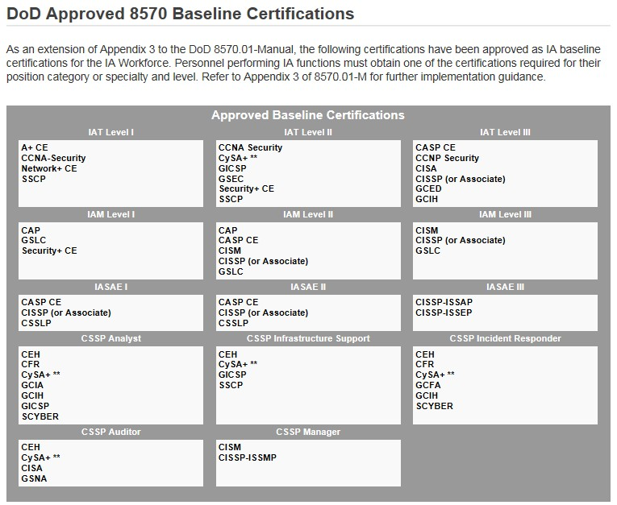
Cyber Workforce Management Program
Cyber Workforce Management Program
DoDD 8140.01 & DoD 8570.01-m for DoD related programs
Applies to DoD and Contractors
Positions dictate which certifications are required https://public.cyber.mil/cwmp/dod-approved-8570-baseline-certifications/ https://public.cyber.mil/cwmp/

Slide 16
CompTIA Certifications
Security+
Network+
Cybersecurity Analyst (CySA+)
Advanced Security Practitioner
Pentest
Linux+
Cloud+
https://certification.comptia.org/certifications https://www.businessnewsdaily.com/10718-comptia-certification- guide.html
Note: Many of these certifications can be obtained at low cost
through your local community college

Slide 17
International Information Systems Security Certification Consortium (ISC2)
Certified Information Systems Security Professional (CISSP)
One of the most widely recognized cybersecurity certifications
Tests security-related managerial skills
Usually more concerned with policies and procedures
Requires that you demonstrate five years of professional experience
Reduced to 4 years if you have a Bachelor’s degree
Can receive the CISSA if you pass the CISSP exam but do not have sufficient experience
Certified Secure Software Lifecycle Professional (CSSLP)
Several other certifications also offered
Web site:
https://www.isc2.org/
https://www.isc2.org/credentials/default.aspx

Slide 18
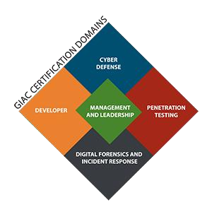
SANS Institute
Highly technical and hands-on training
Learn today and apply tomorrow philosophy
SysAdmin, Audit, Network, Security (SANS) Institute
Offers training and over 20 certifications through Global Information Assurance Certification (GIAC) http://www.giac.org/certifications/get-certified/roadmap
Also offers Master’s Degrees and Certificates in Cyber Security
http://www.sans.edu/
Top 20 Critical Controls
One of the most popular SANS Institute documents
Details most common network exploits
Suggests ways of correcting vulnerabilities
http://www.sans.org/security-resources/
Join the SANS.org community to subscribe to NewsBites & receive free posters https://www.sans.org/account/create

Slide 19
SANS CyberTalent Immersion Academies
An intensive, accelerated training program that provides SANS world class training and GIAC certifications to quickly and effectively launch careers in cybersecurity
100% scholarship-based and no cost to participants
VetSuccess - open to transitioning veterans and those transitioned in the last five years and not currently working in cybersecurity in a civilian role.
Women's Academy - this Academy is open to career-changers and college seniors
with a background in IT, but not currently working in cybersecurity roles.
Cyber Workforce Academy - these Academies are made possible by grants, sponsors and organizations looking to hire cybersecurity talent or help advance the field by bringing in new talent. Academy eligibility requirements and curricula will be based on the specific focus and needs of the sponsors.
Diversity Cyber Academy - SANS and International Consortium of Minority Cybersecurity Professionals (ICMCP) are partnering to create the SANS - ICMCP: Diversity Cyber Academy - DCA, combining efforts to increase the career opportunities for minorities and women in the cybersecurity field.
https://www.sans.org/cybertalent/seekers

Slide 20
EC-Council
International Council of Electronic Commerce Consultants (EC-Council)
Organization’s most recognized certification is the Certified Ethical Hacker (CEH)
Current certification is CEH v10
Based on 20 domains (subject areas)
Also offers other certifications
Forensic Investigator, Application Security Engineer
BS and MS in Cyber Security
https://www.eccouncil.org/

Slide 21
Offensive Security
Creators of Kali Linux
Penetration Testing and IT Security Training & Certifications
Offensive Security Certified Professional (OSCP)
Offensive Security Certified Expert (OSCE)
Offensive Security Certified Web Expert (OSWE)
Offensive Security Certified Exploitation Expert (OSEE)
Offensive Security Certified Wireless Professional (OSWP)
https://www.offensive-security.com/

Slide 22
Employer Training & Collaboration Resources
If you are currently employed, utilize available educational benefits and
training resources.
Not just educational reimbursement programs
Some companies offer access to resources such as lynda.com or degreed.com
Collaborate – many companies have an internal version of LinkedIn
Post your skills internally
Join groups that are related to cybersecurity
Find the cybersecurity personnel at your employer and ask them for advice
They’re typically really friendly people!
Pivot to a cyber security position with your current employer
22

Slide 23
Other Training Resources
LinkedIn Learning (formerly Lynda.com)
Paid subscription https://www.linkedin.com/learning/
How to Access LinkedIn Learning for free through public libraries
Possibly available through your school
Cybrary - Free cybersecurity and IT training https://www.cybrary.it/
Splunk Pledge (Veterans and other groups)
https://workplus.splunk.com/
Public Libraries
LinkedIn Learning
Access to online books
23

Slide 24
For the more “experienced” workers among us…
Stop throwing away those letters from AARP!
How Older Workers Can Learn New Job Skills https://www.aarp.org/work/job-search/info-2018/work-skills-resume-fd.html
Learn@50+ https://learn.aarp.org/
Poor Training, Lack of Skills Leave Older Workers Behind: Study https://insights.dice.com/2019/07/02/skills-older-tech-professionals/

Slide 25
Networking
Invest in & market yourself
Information System Security Association (ISSA) https://www.issa.org
Open Web Application Security Project (OWASP) https://www.owasp.org
Women’s Society of Cyberjutsu (WSC) https://womenscyberjutsu.org/
Women in Cyber Security https://www.wicys.org/
Reverse Shell Corporation https://www.revshellcorp.org/
Null Space Labs https://032.la/
Search for local groups on http://meetup.com
LETHAL, Null Space Labs
Attend conferences
DEF CON https://defcon.org
BSides http://www.securitybsides.com
Grace Hopper Celebration https://ghc.anitab.org/
ShellCon https://shellcon.io
LayerOne https://www.layerone.org/
AppSec California https://2020.appseccalifornia.org/

Slide 26
Professional Reading & Podcasts
7 Must-Read Blogs for Information Security Professionals (Capella University) https://www.capella.edu/blogs/cublog/top-blogs-for-infosec- professionals/
The Top Cyber Security Blogs and Websites of 2019
https://onlinedegrees.sandiego.edu/top-cyber-security-blogs-websites/
SANS Internet Storm Center
https://isc.sans.edu/
SANS Newsbites https://www.sans.org/newsletters/newsbites/
DoD Cyber Exchange – Public https://public.cyber.mil/

Slide 27
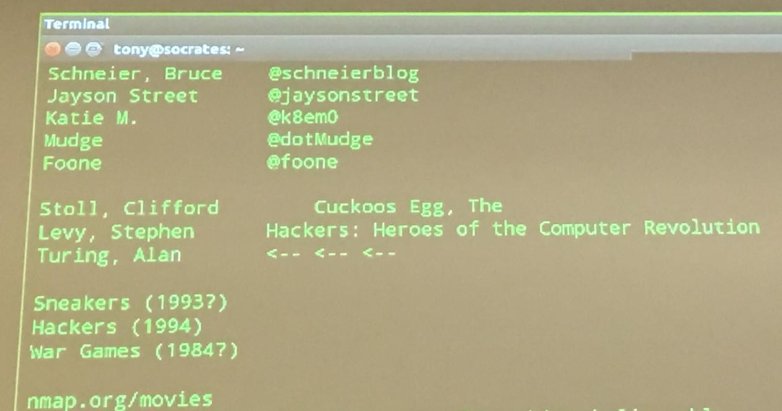
Twitter, Read, and Watch

Slide 28
A Quick Word on Resumes and Applicant Tracking Systems
Resumes
An art form
Everyone who reviews your resume will have a different opinion
You should always have one ready
Update it on a regular basis
You should maintain your resume in two different formats*
*John’s opinion
Human readable for individuals and smaller companies
Longer, more detailed resume for larger companies which utilize…
Applicant Tracking Systems
Resume is scanned and placed in a database
Interviewers rarely see your original resume
Database is searched on key words to find qualified applicants
Use a website such as Jobscan (www.jobscan.co) to evaluate your resume
against a position description
You will be surprised how poorly your resume scores
Plural forms of words is a common problem (e.g. firewalls vs firewall)

Slide 29
THANK YOU

